Slide 1
Competitor Analysis for NAT
https://matrix.juniper.net/docs/DOC-136475
Tony Li
tonyli@juniper.net
ALG-NAT
March 6th. 2013

Slide 2
Agenda
Background Introduction
NAT Overview
Cisco ASA Series
FortiGate Series
Huawei USG Series
Check Point
Juniper SRX Series
Summary
Reference

Slide 3
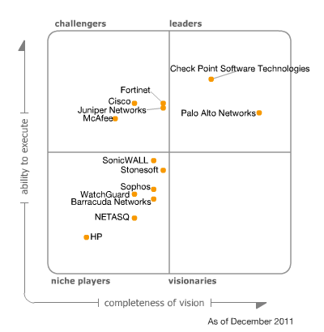
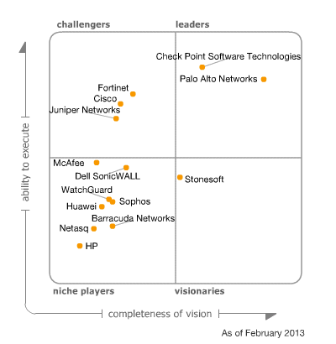
Background introduction
Notes:
Leaders execute well against their current vision and are well positioned for tomorrow.
Visionaries understand where the market is going or have a vision for changing market rules, but do not yet execute well.
Niche Players focus successfully on a small segment, or are unfocused and do not out-innovate or outperform others.
Challengers execute well today or may dominate a large segment, but do not demonstrate an understanding of market direction.

Slide 4



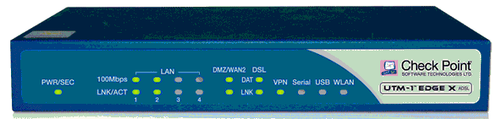
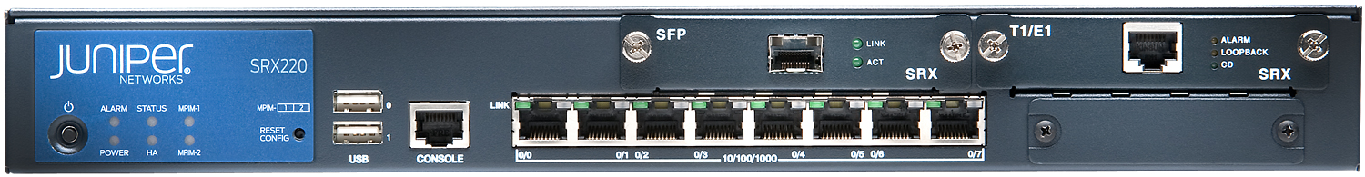
Background introduction

Slide 5
NAT Overview
Basic flavors of NAT
Traditional NAT(source/outbound NAT)
Basic NAT (IP/no port/fix-port translation)
NAPT (PAT/IP masquerading)
Switch-over from Basic NAT to NAPT
Notes:
Traditional NAT(source/outbound NAT)
Traditional NAT is primarily used by sites using private addresses that wish to allow outbound sessions from their site.
Basic NAT (IP/no port/fix-port translation)
A block of external addresses are set aside for translating addresses of hosts in a private domain.
NAPT (PAT/IP masquerading)
NAPT allows a set of hosts to share a single external address. The translations are including not only IP but also transport identifier.
Switch-over from Basic NAT to NAPT

Slide 6
NAT Overview
Basic flavors of NAT
Inbound NAT(DNAT)
Bi-directional NAT
Twice NAT
Proxy-ARP
Notes:
Inbound NAT(DNAT)
Inbound NAT, also named Destination Network Address Translation, changes the destination IP address of an inbound packet and performing the inverse function for any replies.
Bi-directional NAT
With a Bi-directional NAT, sessions can be initiated from hosts in the public network as well as the private network.
Twice NAT
Twice NAT is a variation of NAT in that both the source and destination addresses are modified by NAT.
Proxy-ARP
NAT would be expected to provide ARP support for the address range that belongs to the same subnet.

Slide 7
NAT Overview
NAT Behavioral Requirements
Why defining the new requirements?
The new behaviors can allow many applications to work consistently.
RFC4787: "NAT Behavioral Requirements for Unicast UDP"
RFC5382: "NAT Behavioral Requirements for TCP"
RFC5508: "NAT Behavioral Requirements for ICMP"
Notes:
Why defining the new requirements?
NAT are well known to cause very significant problems with applications carried IP addresses in the payload. Applications that suffer from this problem include Voice over IP and Multimedia over IP, as well as online gaming.
The new behaviors can allow many applications to work consistently.
RFC4787: "NAT Behavioral Requirements for Unicast UDP"
RFC5382: "NAT Behavioral Requirements for TCP"
RFC5508: "NAT Behavioral Requirements for ICMP"

Slide 8
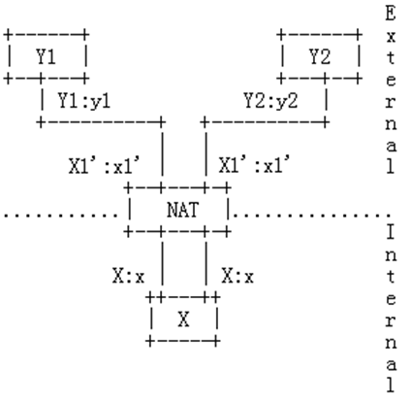
NAT Overview
Address and Port Mapping
Endpoint-Independent
Mapping(EIM)
Address-Dependent
Mapping(ADM)
Address and Port-Dependent
Mapping(APDM)

Slide 9
NAT Overview
Endpoint-Independent mapping
X:x -> Y1:y1 X:x -> Y2:y2
X1’:x1’-> Y1:y1 X1’:x1’-> Y2:y2
Notes:
The NAT reuses the port mapping for subsequent packets sent from the same internal IP address and port (X:x) to any external IP address and port. Specifically, X1’:x1’ for all values of Y2:y2.

Slide 10
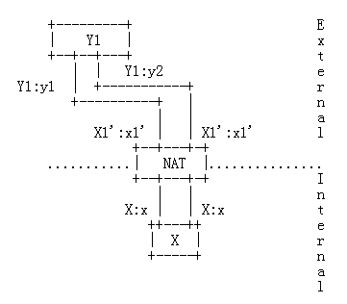
NAT Overview
Address-Dependent Mapping
X:x -> Y1:y1 X:x -> Y1:y2
X1’:x1’-> Y1:y1 X1’:x1’-> Y1:y2
Notes:
Address-Dependent Mapping
The NAT reuses the port mapping for subsequent packets sent from the same internal IP address and port (X:x) to the same external IP address, regardless of the external port. Specifically, X1’:x1’ equals X2’:x2’ if and only if, Y2 equals Y1.

Slide 11
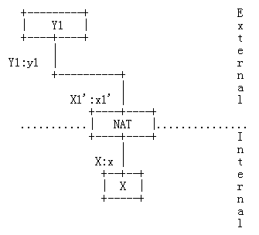
NAT Overview
Address and Port-Dependent Mapping
X:x -> Y1:y1 X:x -> Y1:y2
X1’:x1’-> Y1:y1 X2’:x2’-> Y1:y2
Notes:
The NAT reuses the port mapping for subsequent packets sent from the same internal IP address and port (X:x) to the same external IP address and port while the mapping is still active. Specifically, X1’:x1’ equals X2’:x2’ if and only if, Y2:y2 equals Y1:y1.

Slide 12
NAT Overview
Filter Behavioral
Endpoint-Independent Filter(EIF)
Address-Dependent Filter(ADF)
Address and Port-Dependent Filter(APDF)
Notes:
Filter Behavioral
When an internal endpoint opens an outgoing session through a NAT, the NAT assigns a filtering rule for the mapping between an internal IP:port (X:x) and external IP:port (Y:y) tuple.
Endpoint-Independent Filter(EIF)
Address-Dependent Filter(ADF)
Address and Port-Dependent Filter(APDF)

Slide 13
NAT Overview
Address and Port Assignment
Address assignment
IP address pooling behavior of “Paired”
IP address pooling behavior of “Arbitrary”
IP address pooling behavior of “Shared”
Notes:
IP address pooling behavior of “Paired”
Use the same external IP address mapping for all sessions associated with the same internal IP address.
IP address pooling behavior of “Arbitrary”
Compared to “pared”, some NATs use the external IP address mapping in an arbitrary fashion(i.e., randomly, round-robin).
IP address pooling behavior of “shared”
In basic NAT, each public IP address assign to an internal IP address by default. But due to number limitation of public IP address, some NATs allow different internal IPs with different source ports to use the same external IP.

Slide 14
NAT Overview
Port assignment
Port Preservation
Port overloading
Port ranges
Port Parity
Port re-use
Notes:
Port Preservation
Preserve the port number used internally when assigning a mapping to an external IP address and port.
Port overloading
Always use port preservation even in the case of collision. Most applications will fail if the NAT uses “Port overloading”. So a NAT device must not have the behavior of “Port overloading”.
Port ranges
If the internal host's source port was in the range 0-1023, it is RECOMMENDED the NAT's source port be in the same range. If the host's source port was in the range 1024-65535, it is RECOMMENDED that the NAT's source port be in that range.
Port Parity
Some NATs preserve the parity of the UDP port, i.e., an even port will be mapped to an even port, and an odd port will be mapped to an odd port. It is RECOMMENDED that a NAT have a “Port parity preservation” behavior of “Yes”.
Port re-use
In NAPT mode, some NATs can enable extended NAPT to use ports per service, as opposed to per IP address, by including the destination address and port in the translation information. In other words, they can re-use the same port for different services.

Slide 15
Cisco ASA Series
Cisco ASA5505 with build version 8.4(4)1.
NAT Types in ASA:
Static NAT
Dynamic NAT
Dynamic Port Address Translation (PAT):
Identity NAT
Notes:
ASA: Adaptive Security Appliances (ASA)
Cisco ASA Next-Generation Firewall Services address these needs by adding next-generation capabilities, including Application Visibility and Control (AVC) and Web Security Essentials (WSE), to the industry's most proven stateful inspection firewall. The results are end-to-end network intelligence and streamlined security operations. And your organization can reap the productivity benefits of new applications and devices without compromising security.
Static NAT
A consistent mapping between a real and mapped IP address. Allows bidirectional traffic initiation.
Dynamic NAT
A group of real IP addresses are mapped to a (usually smaller) group of mapped IP addresses, on a first come, first served basis. Only the real host can initiate traffic.
Dynamic Port Address Translation (PAT):
A group of real IP addresses are mapped to a single IP address using a unique source port of that IP address.
Identity NAT:
Static NAT lets you translate a real address to itself, essentially bypassing NAT.

Slide 16
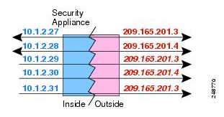
Cisco ASA Series
Static NAT
One-to-one Static NAT
Static NAT with Port Translation
One-to-Many Static NAT
Other Mapping Scenarios for Static NAT
Notes:
Static NAT
One-to-one Static NAT
Static NAT with Port Translation
When specified the port with static NAT, users can choose to map the port to the same value or to a different value.
One-to-Many Static NAT
In one-to-many static NAT, a single real address is mapped to several mapped addresses. When the real host initiates traffic, it always uses the first mapped address. However, for traffic initiated to the host, you can initiate traffic to any of the mapped addresses, and they will be translated to the single real address.
Other Mapping Scenarios for Static NAT
Few-to-many, many-to-few, and many-to-one mappings might result in unintended consequences. Cisco recommends using only one-to-one or one-to-many mappings.

Slide 17
Cisco ASA Series
Dynamic NAT
IP translation
EIM and EIF
PAT as fallback
Notes:
Dynamic NAT
IP translation
Dynamic NAT is same as Basic NAT addressed in overview. Only the real host can initiate traffic.
EIM and EIF
EIM and EIF are supported naturally. IP-to-IP translation mapping will be added into xlate table after session installed. After the session expires, the IP translation also expires after 3 hours of inactivity by default.
PAT as fallback
Users can define a network-object group including one NAT range pool and one single IP address. After the mapped IP addresses of range pool are used up, dynamic PAT is performed using the single IP address. When the PAT translations are also use up, dynamic PAT is performed using the outside interface address.

Slide 18
Cisco ASA Series
Dynamic PAT
EIM and EIF
Port preservation
Flat range
Extended PAT
Round robin
Interface PAT fallback
.
Notes:
Dynamic PAT
EIM and EIF
EIM and EIF are supported naturally. IP port translation mapping will be added into xlate table after session installed. After the session expires, the IP port translation also expires after 30 seconds of inactivity.
Port preservation
ASA tries to keep source port no-translation to avoid breaking applications. If the real port is not available, by default the mapped ports are chosen from the same range of ports as the real port number: 0 to 511, 512 to 1023, and 1024 to 65535. BTW, it can maintain same address-port mappings for different protocols, such as TCP/UDP/ICMP.
Flat range
To avoid running out of ports at the low ranges, configure this setting to use the entire range of 1 to 65535. TCP and UDP cannot share one same port.
Extended PAT
Users can enable extended PAT to re-use the same port for different service.
Round robin
The ASA can enable round-robin address allocation for a PAT pool. Without round robin, by default all ports for a PAT address will be allocated before the next PAT address is used. The round-robin method assigns an address/port from each PAT address in the pool before returning to use the first address again, and then the second address, and so on.
Interface PAT fallback
As same as Dynamic NAT, PAT also can invoke interface PAT fallback. After the primary PAT address(es) are used up, then the IP address of the mapped interface is used.

Slide 19
Cisco ASA Series
Identity NAT
The ASA lets users translate a real address to itself in Static NAT, essentially bypassing NAT. Users might want to configure NAT this way when they want to translate a large group of addresses, but then want to exempt a smaller subset of addresses.
Twice NAT
It lets users identify both the source and destination address in a single rule. If they specify the destination address, they can either map it to itself (identity NAT), or they can map it to a different address. The destination mapping is always a static mapping.

Slide 20
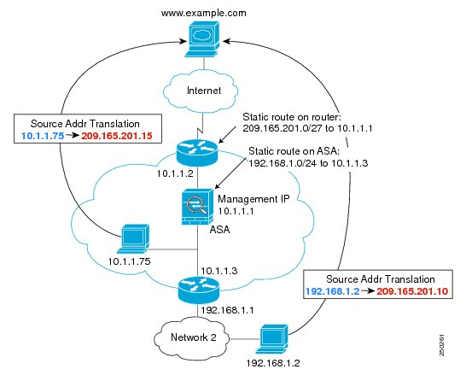
Cisco ASA Series
NAT in Transparent Mode
Notes:
1.When the inside host at 10.1.1.75 sends a packet to a web server, the real source address of the packet, 10.1.1.75, is changed to a mapped address, 209.165.201.15.
2.When the server responds, it sends the response to the mapped address, 209.165.201.15, and the adaptive security appliance receives the packet because the upstream router includes this mapped network in a static route directed through the adaptive security appliance.
3.The adaptive security appliance then undoes the translation of the mapped address, 209.165.201.15, back to the real address, 10.1.1.1.75. Because the real address is directly-connected, the adaptive security appliance sends it directly to the host.
4.For host 192.168.1.2, the same process occurs, except that the adaptive security appliance looks up the route in its route table and sends the packet to the downstream router at 10.1.1.3 based on the static route.

Slide 21
Cisco ASA Series
NAT Implementation
Network object NAT
ASA defines NAT as a parameter for a network object; the network object definition itself provides the real address. It lets users easily add NAT to network objects.
Twice NAT
In this case, NAT is not a parameter of the network object; the network object or group is a parameter of the NAT configuration.
Except session table, ASA also keeps NAT xlate table.
Notes:
Network object NAT
ASA defines NAT as a parameter for a network object; the network object definition itself provides the real address. It lets users easily add NAT to network objects. The objects can also be used in other parts of the configuration, for example, for access rules or even in twice NAT rules.
Twice NAT
User also can identify a network object or network object group for both the real and mapped addresses. In this case, NAT is not a parameter of the network object; the network object or group is a parameter of the NAT configuration.
Except session table, ASA also keeps NAT xlate table. After configured static/identity/twice NAT, the mapping entries are installed statically. For Dynamic NAT and PAT, mapping entries are installed dynamically.

Slide 22
Cisco ASA Series
NAT Rule Matching Order
Section | Rule Type | Order of Rules within the Section
Section 1 | Twice NAT | Applied on a first match basis, in the order they appear in the configuration. By default, twice NAT rules are added to section 1.
Section 2 | Network object NAT | Section 2 rules are automatically determined by ASA. 1. Quantity of real IP addresses: From smallest to largest. 2. The IP address number: From lowest to highest. 3. The name of the network object is used: In alphabetical order.
Section 3 | Twice NAT | Section 3 rules are applied on a first match basis, in the order they appear in the configuration. User can specify whether to add a twice NAT rule to section 3 when you add the rule.
Notes:
Section 2 rules are automatically determined by the adaptive security appliance.
a. Quantity of real IP addresses: From smallest to largest. For example, an object with one address will be assessed before an object with 10 addresses.
b. For quantities that are the same, then the IP address number is used, from lowest to highest. For example, 10.1.1.0 is assessed before 11.1.1.0.
c. If the same IP address is used, then the name of the network object is used, in alphabetical order. For example, abracadabra is assessed before catwoman.

Slide 23
FortiGate Series
FortiGate80C with build version v4.0 MR3
NAT Types in FortiGate:
Static NAT(SNAT)
Static Destination NAT(SDNAT)
Static NAT port forwarding
Dynamic NAT(DNAT)
Dynamic source address translation
Dynamic destination address
Dynamic port forwarding
Notes:
Dynamic destination address
Dynamic destination address NAT (or DDNAT) translates one range of destination
addresses to another range of destination addresses. Whenever a packet within the
specified range of destination addresses to be translated is accepted by a security policy
with DNAT is enabled, the FortiGate unit swaps the packet’s destination address with one
of the addresses from the other specified range.
For example, to allow customers from the Internet to connect to several web servers
protected by a FortiGate unit, you require a range of Internet addresses (for example,
172.16.0.1-10), enough for each protected web server, and a range of real addresses (for
example, 10.0.0.1-10) for each web server. When a packet is received at the external
interface of the FortiGate unit with a destination IP address within the Internet range of
addresses, the FortiGate unit translates the destination address of the packet to the real
address and forwards the packet to the web server on the network protected by the
FortiGate unit.
Dynamic port forwarding
Dynamic port forwarding translates one range of destination addresses and ports to
another range of destination addresses and ports. Whenever a packet with a specified
destination address to be translated is accepted by a security policy with destination NAT
enabled, and a virtual IP with an external port mapped to that address’s port, then the
FortiGate unit swaps the packet’s destination address with the other IP address, and its
port number with the external port.
For example, to allow customers from the Internet to connect to web servers protected
by a FortiGate unit, you require a range of Internet addresses (for example, 172.16.0.1-
10) and a range of port numbers (for example, 80-89), and a range of ports numbers to be
mapped to (for example, 8080-8089). When a packet is received at the external interface
of the FortiGate unit with the 172.16.0.3 destination IP address and port number 8082,
the FortiGate unit translates that address to 10.0.0.3 and port number to 82, and then
forwards the packet to the web server.

Slide 24
FortiGate Series
Static NAT
Virtual IP
Virtual IP performs 1-to-1 mapping.
FortiGate also gives a chose only for Inbound traffic.
Static NAT port forwarding
In specially, there is also static port forwarding, which acts similarly to static NAT, translating a destination address and port number to another destination address and port number.
Notes:
Virtual IP, this will have the added 1-to-1 mapping function that whenever traffic goes from intranet to the Internet as well as traffic comes from Internet to intranet.
Here, static NAT is same as Bi-directional NAT addressed in overview. It is also similar the Static NAT function in Junos SRX. However, FortiGate also gives a chose only for Inbound traffic, translated the public IP addresses to a really intranet IP addresses.
Static NAT port forwarding
In specially, there is also static port forwarding, which acts similarly to static NAT, translating a destination address and port number to another destination address and port number. The difference is that port forwarding requires a virtual IP address so that the FortiGate unit can properly translate the port number.

Slide 25
FortiGate Series
Dynamic source address translation
IP pool
PAT
IP Paired
Overloading
Notes:
Dynamic source address translation
IP pool
PAT
The port range is between 1 and 65535. FortiGate also supports PAT with outgoing interface IP address.
IP Paired
When a client is assigned an IP address from the IP pool, it retains that address.
Overloading
Clients can share pool IP addresses and ports even for fixed port pool. In other words, overload can let private hosts re-use the same IP and port for different service.

Slide 26
FortiGate Series
Central NAT Table
Central NAT table enables NAT rules as well as NAT mappings that are set up by the global firewall table. Multiple NAT rules can be added, and they can be used in firewall policies.
NAT in transparent mode
To support NAT in transparent mode, users need to add a second management IP. These two management IPs must be on different subnets.
Double NAT
Users can combine IP pool and virtual IP as double NAT to perform both source and destination address translation. In fact, it is same as twice NAT addressed in overview.

Slide 27
Huawei USG Series
USG2210 with build version V100R005C00SPC300.
NAT Types in USG series:
Source NAT
Address Mapping
Destination NAT
Notes:
Source NAT in USG2000 series, is same as the traditional NAT addressed in overview. It allows hosts within a private network to access hosts in the public network.
Address Mapping creates a fixed translation of a real address to a mapped address, in USG2000 series. It used to public the server in private network to Internet, so both inbound and outbound traffic can reuse the fixed mapping. Here, address mapping is same as Bi-directional NAT addressed in overview. It is also similar the Static NAT function in Junos SRX.
Destination NAT of USG2000 series is also same as inbound NAT addressed in overview. It also used to public the server in private network to Internet. Compared to address mapping, Destination NAT do not perform the translation initiate from internal.

Slide 28
Huawei USG Series
Source NAT
Supports Basic NAT and NAPT.
Uses special NAT policy to implement source NAT
Address pool
PAT is enable by default
Enable no-pat attribute in NAT policy to perform IP translation
Easy IP:PAT with outgoing interface IP address

Slide 29
Huawei USG Series
Address mapping
Address Mapping creates a fixed translation of a real address to a mapped address. Both inbound and outbound traffic can reuse the fixed mapping.
Address and port mapping
Destination NAT
Compared to address mapping, Destination NAT do not perform the translation initiate from internal.
USG series implements destination NAT via inbound ACL rule and security zone. It uses ACL to permit inbound traffic to virtual IP address, and then associated to really service defined in security zone.

Slide 30
Check Point
NAT types in Checkpoint:
Static NAT
Hide NAT
PAT: dynamically assigned from 600 to 1023 and 10,000 to 60,000.
Port preservation: Ports are normally assigned from the second range. The first range is used for only three services: rlogin, rshell and rexec.
Port translation: Port translation allows multiple application servers in a hidden network to be accessed using a single IP address, based on the requested service (or destination port).
Reusing IP Pool Addresses: IP Pool addresses can be reused for different destinations.
Notes:
Port preservation: Ports are normally assigned from the second range. The first range is used for only three services: rlogin (destination port 512), rshell (destination port 513) and rexec (destination port 514). If the connection uses one of these services, and the original source port is less than 1024, then a port number is assigned from the first range. This behavior is configurable.
Port translation: Port translation allows multiple application servers in a hidden network to be accessed using a single IP address, based on the requested service (or destination port), which saves scarce public IP addresses. A typical implementation enables an FTP server (accessible via port 21), an SMTP server (port 25) and an HTTP server (port 80) to be accessed using a single IP public address.
IP Pool NAT
User can define a separate IP address pool on one or more of the gateway interfaces instead of defining a single pool of IPs for the gateway. Defining an IP pool per interface solves routing issues that occur when the gateway has more than two interfaces. Sometimes it is necessary that reply packets return to the gateway through the same gateway interface. IP Pool NAT can be used both for encrypted and non-encrypted connections.
Reusing IP Pool Addresses
IP Pool addresses can be reused for different destinations, which make more efficient use of the addresses in the pool. If a pool contains N addresses, then any number of clients can be assigned an IP from the pool as long as there are no more than N clients per server. Using IP Pool allocation per destination, two different clients can receive the same IP from the pool as long as they communicate with different servers. When reusing addresses from the IP Pool, back connections are supported from the original server only. This means that connections back to the client can be opened only from the specific server to which the connection was opened.

Slide 31
Juniper SRX Series
SRX implements NAT as following:
Static NAT
Basic Static NAT
Static NAT with Port Translation
Destination NAT: IP translation/PAT
Source NAT
Basic source NAT
Persistent NAT
IPv6 support: IPv6 NAT/NAT-PT/NAT64
Proxy-ARP/Proxy-NDP

Slide 32
Juniper SRX Series
Source NAT
IP-shift
IP translation: Overflow pool/Interface, IP-shared
PAT
Port range
Port allocation: random/round robin
Port overloading
PAT with outgoing interface
IP-paired
Address-persistent
Persistent NAT
Address mapping and address-port mapping
Any-remote-host/target-host/target-host-port(EIM and EIF/ADF/APDF)

Slide 33
Summarization
NAT implementation: rule based or policy based?
The advantage to invoke NAT in firewall policy
It has more detail match conditions, and also can add schedule/authentication attributes for NAT action.
It can save more memory, and accelerate rule/policy matching process.
The advantage to invoke NAT in special rule
It is more flexible for setup it regardless of policy.
It may have different match conditions.
It is a more general way for networking devices, not only for firewall devices.

Slide 34
Summarization
NAT Functionality
NAT behaviors
Basic NAT types: Cisco/Juniper
EIM and EIF: Juniper/Cisco
Address and port assignment: Cisco/Juniper
Working scenarios
Transparent mode: Cisco and FortiGate
IPv6 Supporting
HA and Logical system
Management Usability
CLI: Cisco/Juniper
Web management: FortiGate/Cisco

Slide 35
Summarization
 |  |  | Juninper SRX | Cisco ASA | Fortinet FortiGate | Huawei USG2000
Version |  |  | X45 | 8.4(4)1 | v4.0, MR3 | V100R005C00SPC300
Static NAT | Address mapping |  | Y | Y | Y | Y
 | Address and port mapping |  | Y | Y | Y | Y
 | M to N mapping |  | N | Y | N | N
 | Bi-directional mapping |  | N | Y | Y | N
Destination NAT | Basic destination NAT |  | Y | Y | Y | Y
 | Destination port translation |  | Y | Y | Y | Y
Source NAT | Static IP mapping |  | Y | Y | Y | N
 | Dynamic IP | IP translation | Y | Y | Y | Y
 |  | IP shared | Y | Y | N | N
 |  | PAT fallback | Y | Y | N | N
 | PAT | Port preservation no PAT | N | Y | N | N
 |  | Port ranges | N | Y | N | N
 |  | Port parity | N | Y | N | N
 |  | Port reuse | Y | Y | Y | Y
 |  | Port parity | N | Y | N | N
 |  | IP paired | Y | Y | Y | Y
 |  | Outgoing interface | Y | Y | Y | Y
 | Address and port mapping | EIM | Y | Y | N | N
 |  | Session limitation | Y | N | N | N
 |  | Mapping timeout | Y | Y | N | N
 | Filter behavior | EIF | Y | Y | N | N
 |  | ADF | Y | N | N | N
 |  | APDF | Y | N | N | N
Twice NAT |  |  | Y | Y | Y | Y
Proxy ARP for NAT |  |  | Y | Y | Y | Y
IPv6 support |  |  | Y | N | N | N
NAT in transparent mode |  |  | N | Y | Y | N

Slide 36
Reference
[1] RFC2663, IP Network Address Translator (NAT) Terminology and Considerations.
[2] RFC3022, Traditional IP Network Address Translator.
[3] RFC3489, STUN - Simple Traversal of User Datagram Protocol (UDP) Through Network Address Translators (NATs).
[4] RFC4787, NAT Behavioral Requirements for Unicast UDP.
[5] RFC5382, NAT Behavioral Requirements for TCP.
[6] RFC5508, NAT Behavioral Requirements for ICMP.
[7] RFC6144, Framework for IPv4/IPv6 Translation.
[8] RFC6146, Stateful NAT64: Network Address and Protocol Translation from IPv6 Clients to IPv4 Servers.
[9] Cisco ASA84 CLI Manual.
[10] FortiOS handbook for 4.0 MR3.
[11] CheckPoint Firewall AdminGuide for R75.40.

Slide 37
Q & A
Notes:
37

